Slide 1
Search Engines 🔍
Hey Google, what is a workshop?
By: Anthony Hevia
9/17/2020

Slide 2

Introduction 💬
Senior UCF CS Major ⚔
Incoming Software Engineer @ Microsoft (not on Bing 😢)
Undergrad researcher in evolutionary computation and bioinformatics
Shameless Twitter plug: @starch_wars 🦜

Slide 3
Learning Outcomes 📕

Slide 4


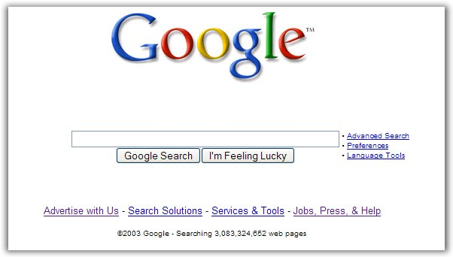
Search Engines have 3 main ingredients….. 👩🏽‍🍳
Web Crawlers
Databases/Index
Search Bar

Slide 5
What are some assumptions people have about search?

Slide 6
Falsehoods about Search 😲
Customers know what they’re looking for
Customers notice their own misspellings
It is possible to create a list of all misspellings
Customers want their misspellings corrected
You can pass the customer query directly to your engine
Once setup, search will work the same way forever
The default search engine settings are great for everyone

Slide 7
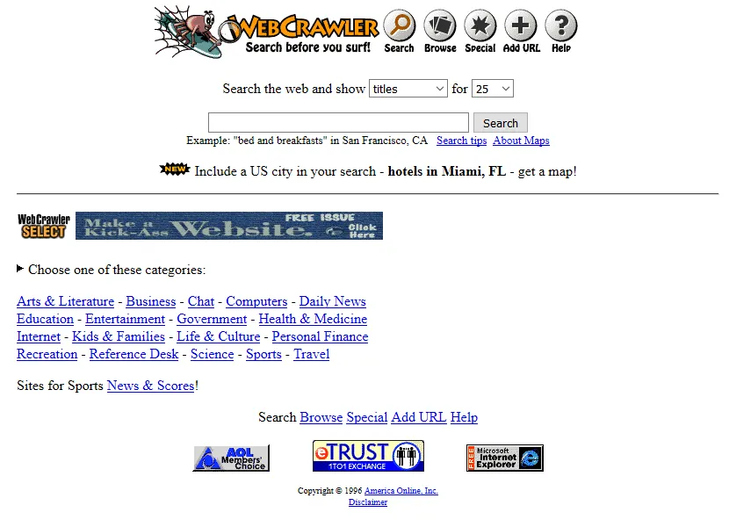
The first(ish) ever Search Engine ⌛
Notes:
Released in April 1994 out of UW, the first search engine to take advantage of web crawlers

Slide 8
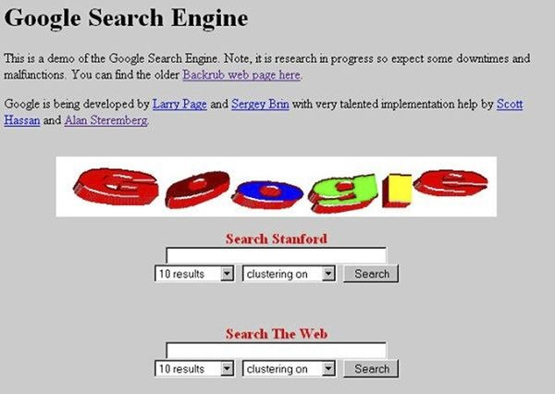
Early days of Google ⌛
Notes:
Google started out at Stanford, this photo dates back to 1997

Slide 9
How do you think a Search engine “searches”?

Slide 10
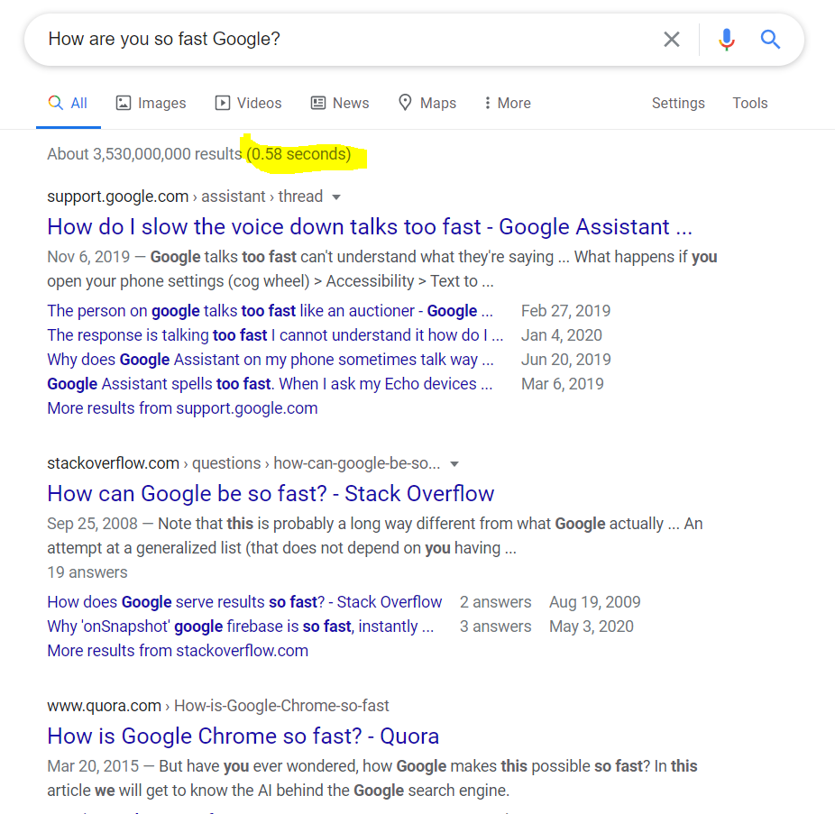
How do we efficiently “search” for things? 1/2🚅
How was Google about to search 3 billion results in under a second?
It obviously did not search the entire web, but the results are relevant!
If you did a keyword search over the entire web, the runtime would be insane!

Slide 11
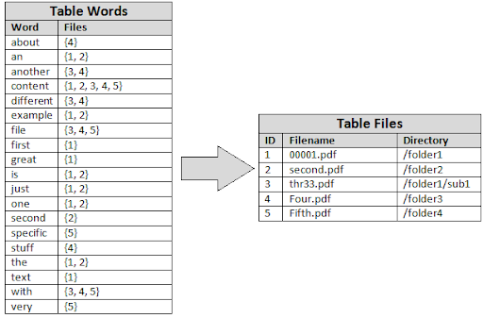
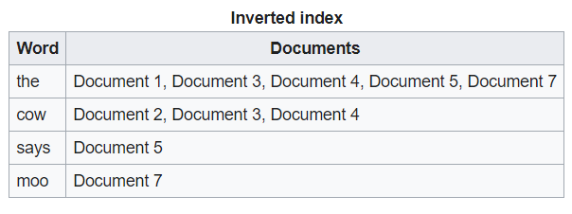
How do we efficiently “search” for things? 2/2🚅
We use an Inverted Index!
Based off of Hashtable data structure
Key, Value pairs
O(1) lookup value!
“Words” are the keys and “sites” are the value
Large Search engines often use compression or other memory techniques to reduce size

Slide 12
In what ways can we improve Search?

Slide 13
Improving the Search Experience 🔎
Ranking the results
Personalizing the results based on location, user preferences
Spelling corrections
Knowing the local lingo
Keeping up to date with current events
Interpreting meaning in sentences:
How old does X animal live?
How long does X animal live?

Slide 14
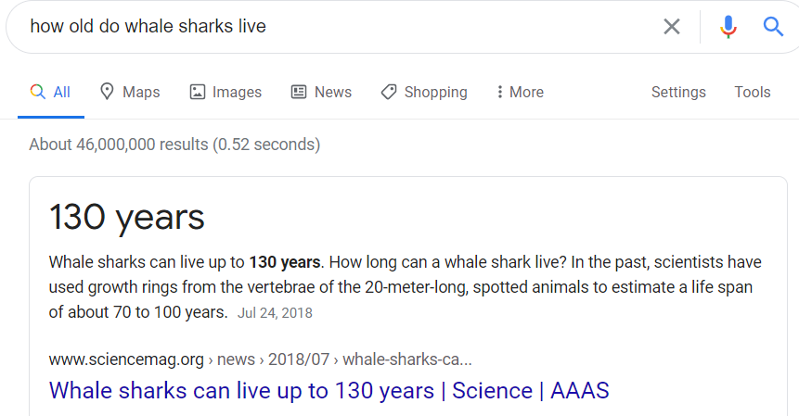
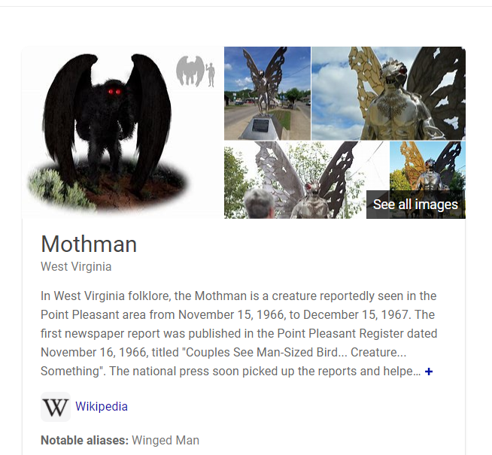
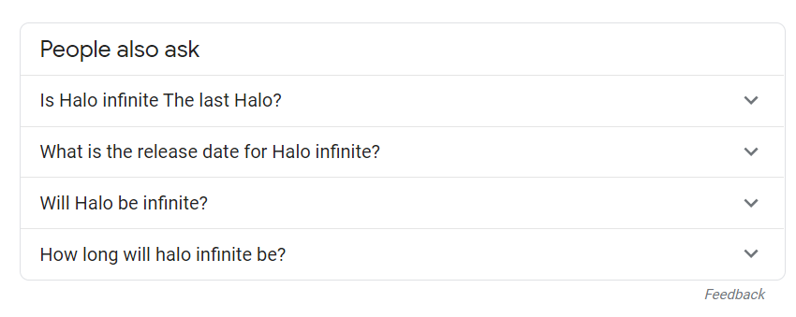
Improving the Search Experience through UI/UX 🔎

Slide 15
How does AI help with Search? 🧠
Mapping queries to knowledge in a database
NLP techniques can help us understand language
Giving relevant results
Offering alternative search queries
Helps users narrow down what they’re looking for
Displaying relevant info panels

Slide 16
How should we rank search results?

Slide 17
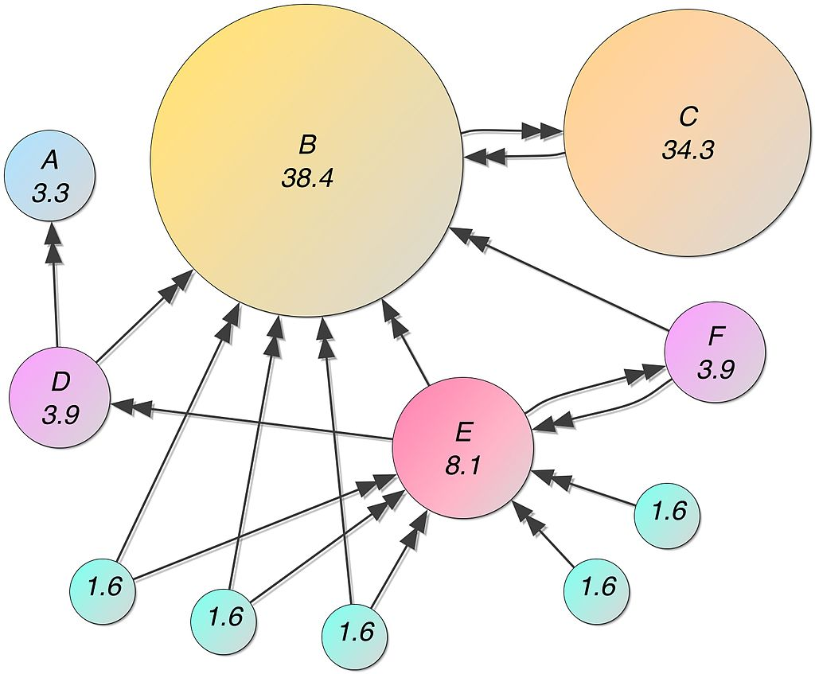
Early days of ranking results
Research into “weighed results” dates back as early as 1977!
Google’s PageRank algorithm in a nutshell:
The value of a website is proportional to how many other websites link to it

Slide 18
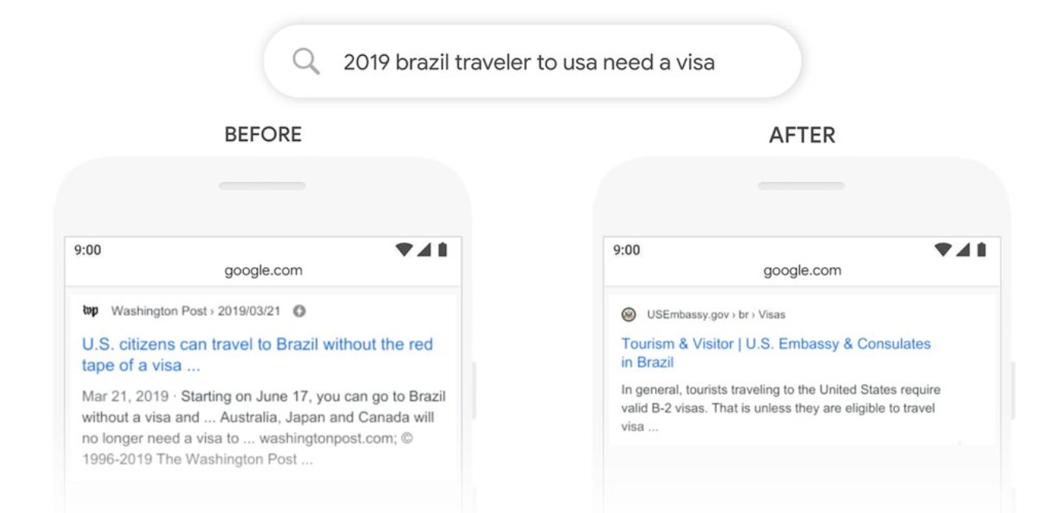
Modern day ranking
Modern day search often now uses modern AI/ML/NLP techniques to power search and better understand natural language
Notes:
Google began experimenting with BERT in their search engine in late 2019

Slide 19
Engineering Challenges 🚂
Users want their results FAST!
The web is always changing and being updated at a rapid pace, how do we keep our database updated?
How do we store data efficiently? we can’t possibly search every single webpage in our index
How do we handle hundreds, to thousands of searches a second? (As of 2019, Google reports 70,000 searches a second)

Slide 20
Making Search more accessible 👩🏽‍💻
Offering alternatives to standard Search (image search, speech to text, virtual assistants, smart speakers, etc)
Respecting the uniqueness of the user’s language and dialect (and how its expressed in their search query)
Offering results that respect accessibility guidelines for devices
Not unintentionally linking hateful content or misinformation

Slide 21
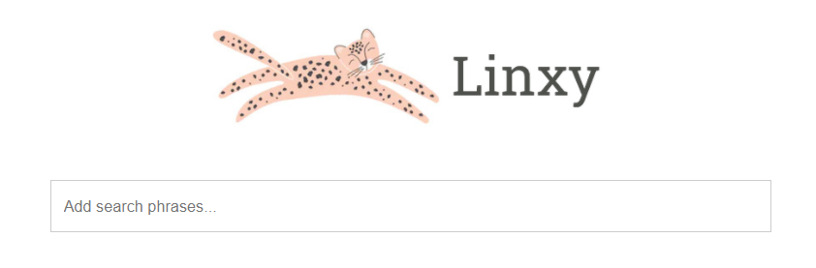
Specialized Search Engines 🕵🏽‍♀️
Linxy is a search engine that indexes just news outlets

Slide 22

Specialized Search Engines 🕵🏽‍♀️
SplitSearch is a Search Engine when you enter a political term it tries to search both sides on the issue

Slide 23
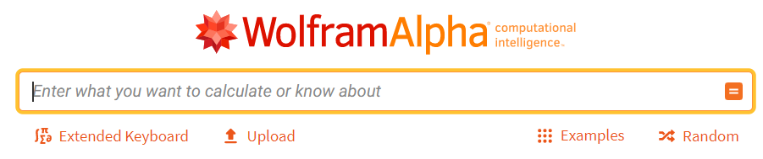
Specialized Search Engines 🕵🏽‍♀️
WolframAlpha is an example of a search engine over an entire curated Knowledge Base made by experts and various data sources

Slide 24
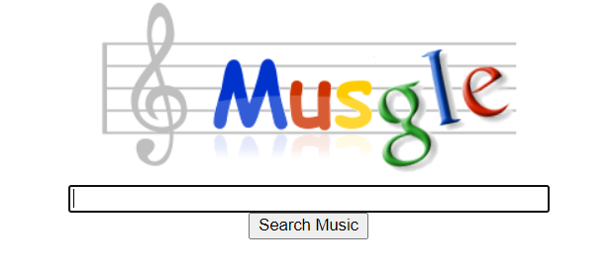
Specialized Search Engines 🕵🏽‍♀️
Musgle, a search engine for finding music

Slide 25
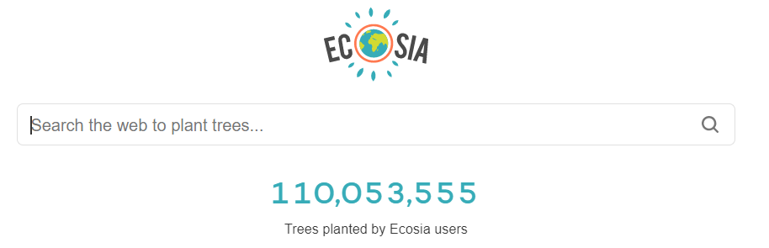
Specialized Search Engines 🕵🏽‍♀️
Ecosia is a search engine that uses part of its ad revenue to fund charities that plant trees in vulnerable areas of the world

Slide 26
Quick Question break? 🙋

Slide 27

Implementing a Web Crawler 101 🕷
If you’re prototyping:
Python + Beautifulsoup
Quick to iterate/prototype and see results
Great for beginners!
For Production, consider a low level language
Rust/C++/Go/etc
Concurrency/Parallelism can help improve crawling speed and range
Make sure to respect a websites web scraping rules!
Add /robots.txt to the end of any url to see what they are

Slide 28

What Database/Index should I use? 💾
Most modern databases have extensions for quickly indexing information
Common recommendations include:
PostgresQL
MariaDB/MySQL
Neo4J (if creating a knowledge base)
Other considerations:
The schema of our data, is it easy to navigate? Is it too nested?
Does it represent how we want users to search?

Slide 29





How can we access the database? 🐍
Create an API in your favorite language!
Make sure it has drivers/support for the database you’re using
Some great choices:
Python
Rust/C++/Go
Java
Node.js/TypeScript
C#

Slide 30



Creating the Search Bar 🔎
Your search bar can live anywhere, website, mobile, desktop!
Use whatever language works best
For Websites:
React, Vue, HTML/CSS
For Mobile:
Swift, Java/Kotlin, React Native, Flutter
For Desktop:
Electrion, Native GUI APIs

Slide 31




Premade Search APIs 💻
Google’s “Programmable Search Engine”
https://programmablesearchengine.google.com/about/
Azure Cognitive Service’s “Bing Search API”
https://azure.microsoft.com/en-us/services/cognitive-services/bing-web-search-api/
Wolfram Alpha and Algolia also provide Search APIs

Slide 32

Open Source Solutions 📚
MeiliSearch (a search engine written in Rust)
Easy to implement on your own database!
Provides the Search Bar and returning results
Apache Lucene & Solr
Full search engine in Java
Provides a lot of extra features for fault tolerance
ElasticSearch
Popular Search solution you can use with your database/product
Used by a lot of major companies and supported on most cloud providers

Slide 33
Where to go next? ⌚
Go through the various topics here and find one that interests you!
https://github.com/frutik/awesome-search
Use one of the search APIs or use an open source solution
Try to implement an aspect of search engine yourself!
Dive deeper into the field of AI/NLP
References & Resources can be found at:
https://github.com/Hevia/workshops

Slide 34
Questions? 🙋

